Slide 1
SER 334 A Session
SI Session
Thursday, January 11th 2024
7:00 pm - 8:00 pm MST

Slide 2
{
Agenda
What is SI?
About Me
Session Times & Expectations
Pointers
Course Tips!

Slide 3
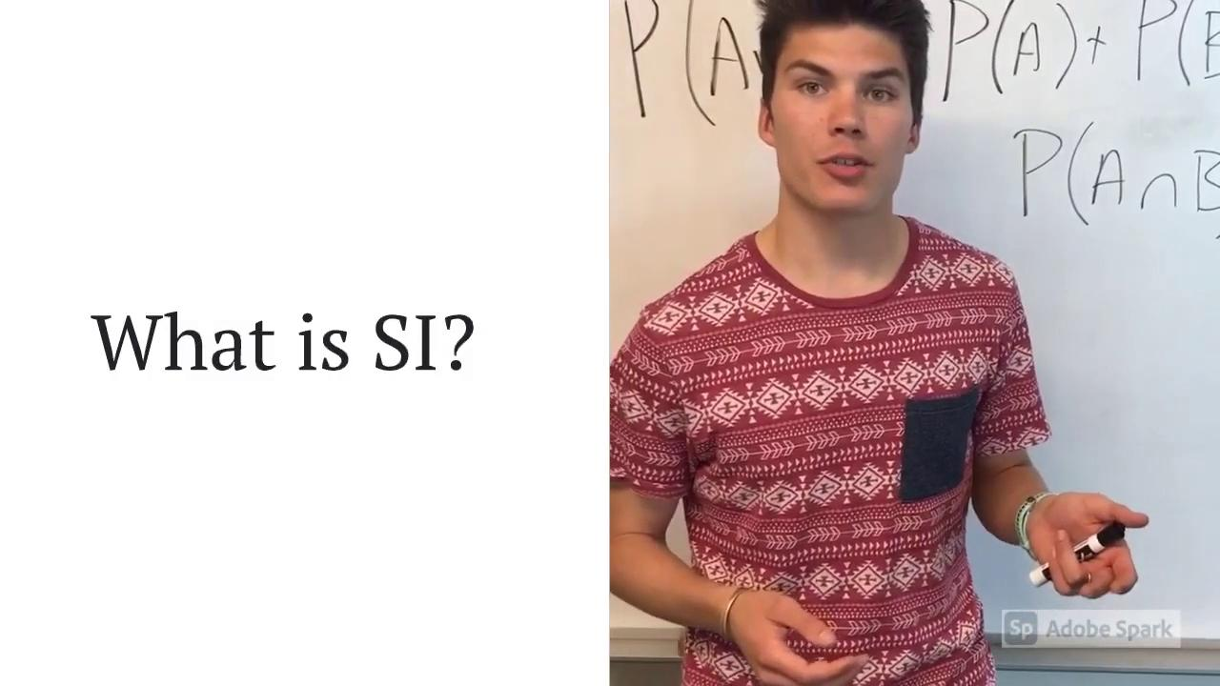
What is SI?
Informational Video

Slide 4

About Me
Katie
Born and raised near Chicago, Illinois
Moved around within the Northern Suburbs
Currently in Grayslake
Work at a family-owned Italian restaurant
Received AS from my local Community College
Transferred to ASU at the start of 2020
Majoring in Software Engineering
Runs in the family
Father is a Software Architect
Mother is a Quality Assurance Analyst
Add Picture

Slide 5
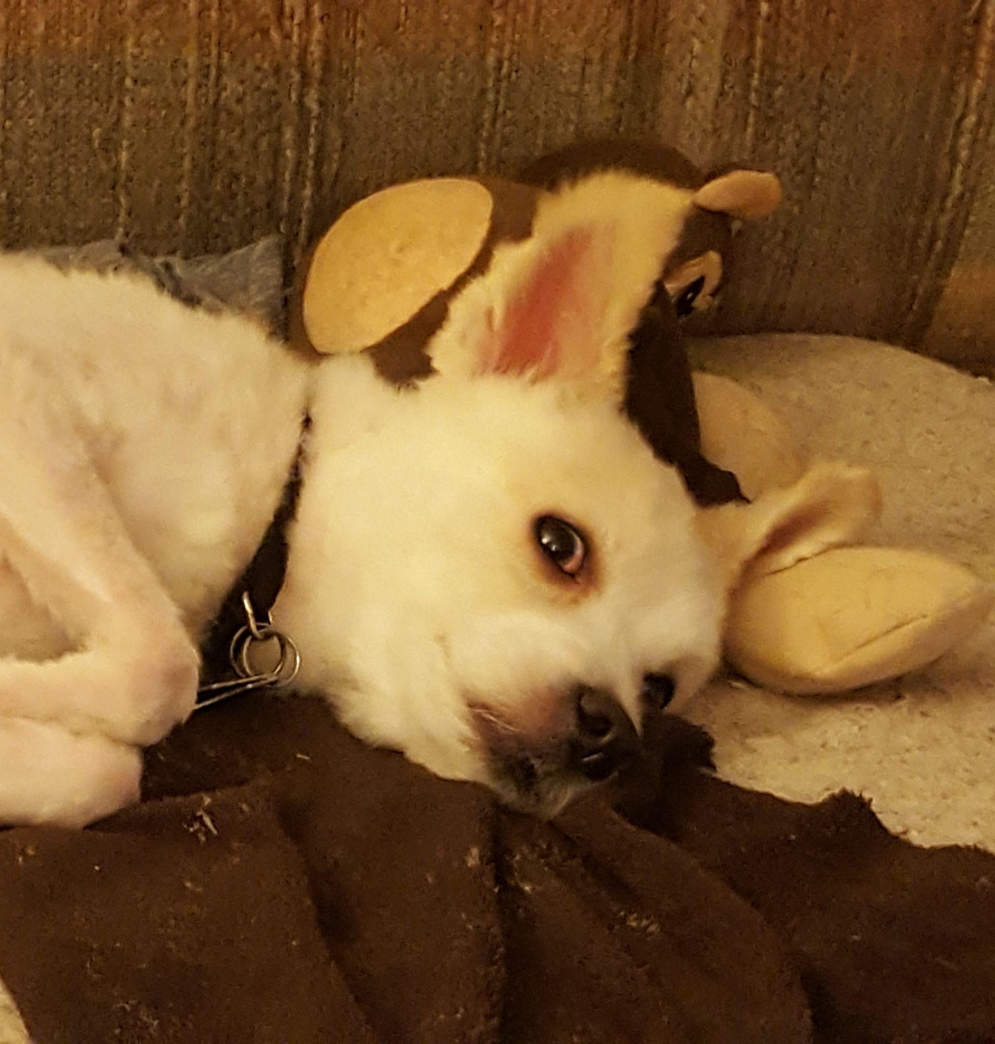






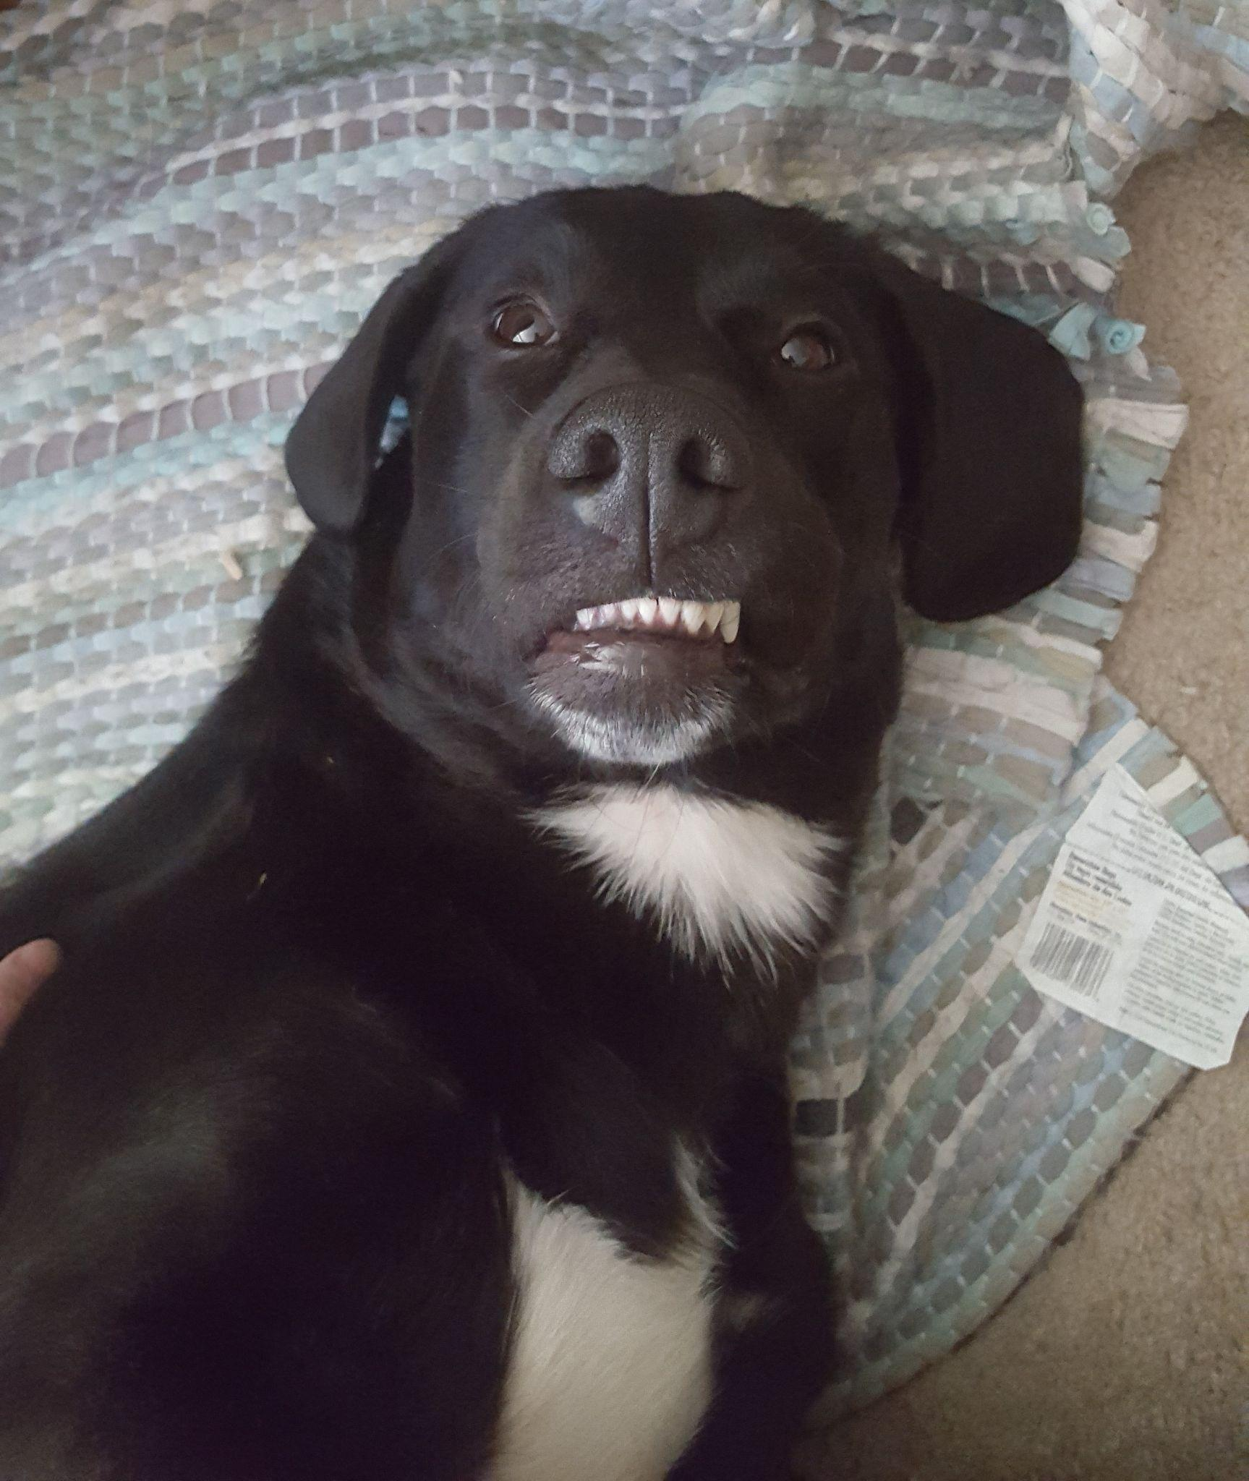


About Me
Katie
Hobbies
Gaming
Football (Go Bears!)
Reading
Learning
Doggos! 😊

Slide 6
SI Session Expectations
Thanks for coming to the SER 334 SI session. We have a packed agenda and we are going to try to get through as many of our planned example problems as possible. This session will be recorded and shared with others.
If after this you want to see additional examples, please visit the drop-in tutoring center.
We will post the link in the chat now and at the end of the session.
Please keep in mind we are recording this session and it will be made available for you to review 24-48 hours after this session concludes.
Finally, please be respectful to each other during the session.

Slide 7

Interact with us:
Zoom Features
Zoom Chat
Use the chat feature to interact with the presenter and respond to presenter’s questions.
Annotations are encouraged.

Slide 8
SER 334:
C
Java
C v. Java
Notes:
BOTH:
Programming language
High-level languages (definitely not low-level)
Imperative ⇒ use statements to change a program’s state
Established
Use libraries
Etc
JAVA:
Object oriented
Strongly typed
Garbage collection
Tries to help you be a good programmer
C:
Functional
Weakly Typed
No garbage collection
**You are responsible for memory management!!
**pointers!!

Slide 9
What is a pointer?
SER 334:
Pointers
int *ptr;
Variable
Value is a memory address
Notes:
Implications we can think of?
Would that give us more power or less power?

Slide 10

What is a pointer?
SER 334:
Pointers
0x5500
0x5504
0x5508
0x5512
?
int val = 99;
int *ptr = &val;
99
600
What is the value of the pointer now?
Notes:
Okay let’s look at operators before we get any deeper…

Slide 11
Two Pointer Operators
What is a pointer?
SER 334:
Pointers
0x5500
0x5504
0x5508
0x5512
?
int val = 99;
int *ptr = &val;
99
600

Slide 12
Reference or Dereference?
What is a pointer?
SER 334:
Pointers
*
Dereference
Value at
&
Address of
Reference
Notes:
What does that mean?

Slide 13
* Value at
& Address of
SER 334:
Pointers
0x5500
0x5504
0x5508
0x5512
0x5508
?
int val = 99;
int *ptr = &val;
99
ptr
=
& Address of
val
600
What is the value of the pointer now?
Notes:
Let’s assume the ptr is at 0x5500

Slide 14
* Value at
& Address of
SER 334:
Pointers
0x5500
0x5504
0x5508
0x5512
0x5508
0x5512
int val = 99;
int *ptr = &val;
ptr = ptr + 4;
99
600
Notes:
Will then be 0x5503

Slide 15
* Value at
& Address of
SER 334:
Pointers
0x5500
0x5504
0x5508
0x5512
0x5512
int val = 99;
int *ptr = &val;
ptr = ptr + 4;
99
The value at
*ptr = 5;
600
This location
Notes:
***** Because pointers store memory addresses!!

Slide 16
* Value at
& Address of
SER 334:
Pointers
0x5500
0x5504
0x5508
0x5512
0x5512
int val = 99;
int *ptr = &val;
ptr = ptr + 4;
99
The value at
*ptr = 5;
600
5
This location
Notes:
Talk about how it gives you lots of power when you can traverse mem like that (byte addressable)
But is also dangerous - overflow or changing other parts of that prog

Slide 17
0x1110 | 57
0x1111 | NULL
0x1112 | K
0x1113 | a
0x1114 | t
0x1115 | i
0x1116 | e
0x1117 | \0
0x1118 | 99
0x1119 | 0x1118
0x1120 | 97
0x1121 | 0x1112
0x1122 | j
SER 334:
ptr
Pointers
char *ptr = “Katie”;
Pointers are variables that store…
Notes:
Lectures illustrated like so, with the pointer literally pointing to the location… good so far?

Slide 18

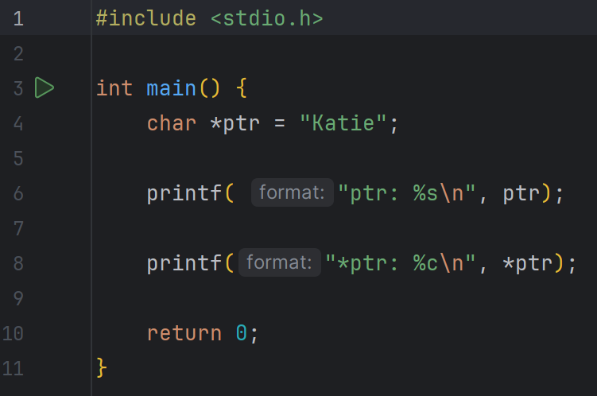
0x1110 | 57
0x1111 | NULL
0x1112 | K
0x1113 | a
0x1114 | t
0x1115 | i
0x1116 | e
0x1117 | \0
0x1118 | 99
0x1119 | 0x1118
0x1120 | 97
0x1121 | 0x1112
0x1122 | j
SER 334:
ptr
Pointers
char *ptr = “Katie”;
Pointers are variables that store…
What’s this again?

Slide 19
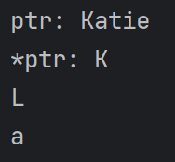
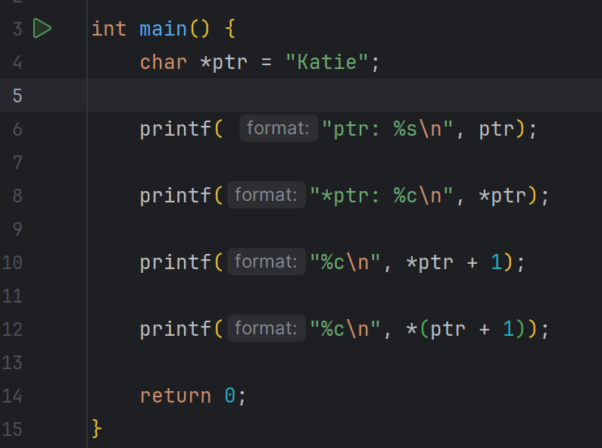
0x1110 | 57
0x1111 | NULL
0x1112 | K
0x1113 | a
0x1114 | t
0x1115 | i
0x1116 | e
0x1117 | \0
0x1118 | 99
0x1119 | 0x1118
0x1120 | 97
0x1121 | 0x1112
0x1122 | j
SER 334:
ptr
Pointers
char *ptr = “Katie”;
Pointers are variables that store…

Slide 20
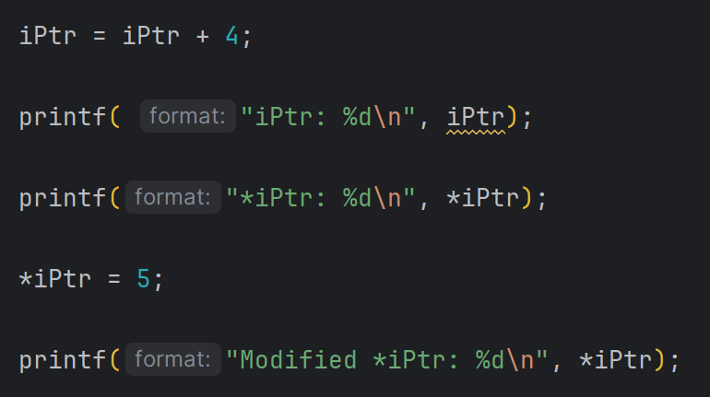
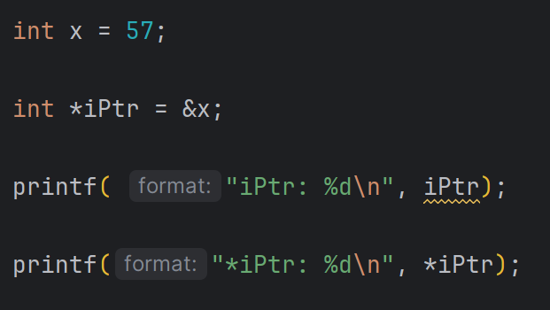
iPtr
0x1110 | 57
0x1111 | NULL
0x1112 | K
0x1113 | a
0x1114 | t
0x1115 | i
0x1116 | e
0x1117 | \0
0x1118 | 99
0x1119 | 0x1118
0x1120 | 97
0x1121 | 0x1112
0x1122 | j
SER 334:
ptr
Pointers
Notes:
First prints address
Then prints 57

Slide 21
iPtr
0x1110 | 57
0x1111 | NULL
0x1112 | K
0x1113 | a
0x1114 | t
0x1115 | i
0x1116 | e
0x1117 | \0
0x1118 | 99
0x1119 | 0x1118
0x1120 | 97
0x1121 | 0x1112
0x1122 | j
SER 334:
ptr
Pointers
Notes:
Prints new address
Then whatever is currently there
Then we update to 5
Prints 5

Slide 22

SER 334:
Tips for Success!
Start assignments ASAP and go one step at a time
Monitor the slack channels!
Ask questions right away
Use the Course Repo - it’s there for a reason!
Katie Tip:
Make a general reference sheet!
Add notes for concepts you struggle with
Can then filter the sheet into your note card for the Exam!
You are given a sheet for Unit 1, maybe add onto that!

Slide 23
Upcoming Events
SI Sessions:
ASN is Closed Sunday, January 14th and Monday, January 15th
Thursday, January 18th at 7:00 pm MST
Sunday, January 21st at 7:00 pm MST
Monday, January 22nd at 7:00 pm MST
Review Sessions:
Exam 1 Review: Thursday, January 25th 7:00 pm - 9:00 pm MST

Slide 24

Questions?
Survey:
http://bit.ly/ASN2324

Slide 25


More Questions?
Check out our other resources!
tutoring.asu.edu
1-
2-
Click on ‘Go to Zoom’ to log onto our Online Tutoring Center.
Click on ‘View the tutoring schedule’ to see when tutors are available for specific courses.

Slide 26
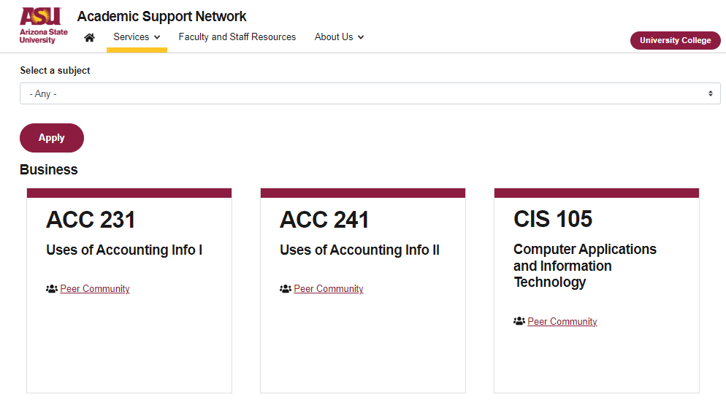

More Questions?
Check out our other resources!
tutoring.asu.edu/online-study-hub
Don’t forget to check out the Online Study Hub for additional resources!

Slide 27
Additional Resources
Course Repo

